Slide 1

Cell Biology Lec (9)
Cancer cell

Slide 2
Cancer cell
• Cell division is a normal process used by the body for growth and repair. A parent cell divides to form two daughter cells, and these daughter cells are used to build new tissue, or to replace cells that have died as a result of ageing or damage.
• Healthy cells stop dividing when there is no longer a need for more daughter cells, but cancer cells continue to produce copies. They are also able to spread from one part of the body to another.
• Cancer is defined as the continuous uncontrolled growth of cells forming tumours. Cancer could be solid or liquid (blood with abnormal cells).
• Tumor is a group of cells that have undergone unregulated growth, will often form a mass or lump.
• Tumors divided to benign or malignant.

Slide 3
Benign | malignant
small size | Irregular shape
slow growth | rapid growth
non-invasive (localized) | invasive
no metastasis | metastasis
delineated by a fibrous capsule | No capsule
become problems due to complete bulk | cause death

Slide 4
* metastasis: The spread of cancer cells from the place where they first formed to another part of the body. In metastasis, cancer cells break away from the original (primary) tumor, travel through the blood or lymph system, and form a new tumor in other organs or tissues of the body. The new, metastatic tumor is the same type of cancer as the primary tumor. For example, if breast cancer spreads to the lung, the cancer cells in the lung are breast cancer cells, not lung cancer cells.

Slide 5
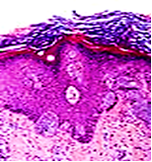
Cancer types
•There are different categories of cancer, defined according to the cell type from which they originate:
1.Carcinoma: the majority of cancer cells are epithelial in origin, beginning in the membranous tissues that line the surfaces of the body.

Slide 6
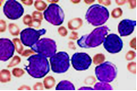
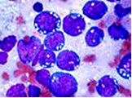
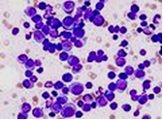
Cancer types
2.Leukaemia: originate in the tissues responsible for producing new blood cells, most commonly in the bone marrow.
3.Lymphoma and myeloma : derived from cells of the immune system.

Slide 7
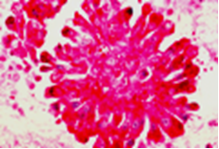
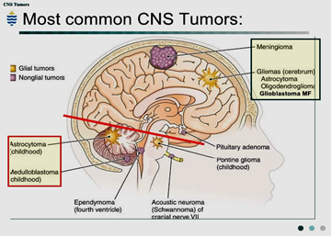
Cancer types
4. Sarcoma: originating in connective tissue, including fat, muscle and bone.
5. Central nervous system: derived from cells of the brain and spinal cord.

Slide 8
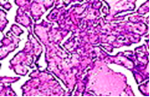
Cancer types
Mesothelioma : originating in the
mesothelium; the lining of body cavities.
Causes of cancer
Chemicals: Exposure to particular substances have been linked to specific types of cancer. These substances are called carcinogens.
2) Radiation: Radiation can cause cancer in most parts of the body in all animals and at any age. Prolonged exposure to ultraviolet radiation from the sun can lead to melanoma and other skin cancers.

Slide 9
Causes of cancer
3) Heredity: Hereditary cancers are primarily caused by an inherited genetic defect.
4) Physical agents : Some substances cause cancer primarily through their physical rather than chemical effects. physical carcinogens must get inside the body (such as through inhalation) and require years of exposure to produce cancer.
5) Infection: Worldwide approximately 18% of cancer deaths are related to infectious diseases. Viruses (Oncoviruses) are the usual infectious agents that cause cancer, also bacteria and parasites may play a role.

Slide 10
Management or treatment of cancer
Surgery : is the primary method of treatment for most isolated, solid cancers. For some types of cancer this is sufficient to eliminate the cancer.
2. Chemotherapy : is the treatment of cancer with one or more cytotoxic anti-neoplastic drugs, traditional chemotherapeutic agents act by killing cells that divide rapidly, a critical property of most cancer cells. In combination with surgery, chemotherapy has proven useful in cancer types including (breast cancer, colorectal cancer, pancreatic cancer, osteogenic sarcoma, testicular cancer, ovarian cancer and certain lung cancers.

Slide 11
Management or treatment of cancer
3. Radiation : Involves the use of ionizing radiation in an attempt to either cure or improve symptoms. It works by damaging the DNA of cancerous tissue, killing it. Radiation is typically used in addition to surgery and or
chemotherapy.
4. Targeted therapies : Targeted therapy, which first became available in the late 1990s. This constitutes the use of agents specific for the deregulated proteins of cancer cells , small molecule targeted therapy drugs are generally inhibitors of enzymatic domains on mutated, overexpressed or critical proteins within the cancer cell.

Slide 12
Management or treatment of cancer
5. Immunotherapy : A variety of therapies using immunotherapy, stimulating or helping the immune system to fight cancer, have come into use since 1997. This treatment is given together with the other types of treatment such as Surgery, radiotherapy and Chemotherapy.
6. Hormonal therapy : The growth of some cancers can be inhibited by providing or blocking certain hormones. Common examples of hormone-sensitive tumors include certain types of breast and prostate cancers.
7. Alternative medicine : They include diet and exercise, chemicals, herbs, devices, and manual procedures.

